Slide 1
Does the size of a household impact ability to obtain higher education
Team Dingo Members:
Nick Adzema, Alice Arnold, Jasmine Bates, Maxbooz Homidas

Slide 2

How did we arrive at this topic?
Notes:
Jasmine
Cost of higher education continues to increase
Wanted to see what some of the impacts are to being able to afford higher education
There were many different factors, but the household size was one that we had not really heard of being tested before

Slide 3
Hypothesis
1
2
Ho : The household size has no impact on the ability to obtain higher education
HA: The household size does have impact on the ability to obtain higher education
Notes:
Maxbooz

Slide 4


The Process
WHAT ARE THE THINGS WE DID TO GET THE DATA
WHAT WERE SOME OF THE CHALLENGES IN FINDING THE DATA
Notes:
Nick - as a group, we looked at many sources of data (kaggle, census, google public data)
#1 being able to extract reliable data.
Census had many categories of higher education.
There was overlapping data such as getting your bach. means having 3+ college as well. Our focus was more on higher education enrolled with a bachelor’s degree since the data would be more clear on who is going to college as a fixed variable. We grabbed from US census for both bachelor’s degree percentage per county of each state and average household size per county of each state.
Since we are comparing states, we took the averages of bachelor’s degree attained percentage per state vs average household size of each state. Then we compared.
The challenges in finding this type of data is finding a good resource that had all parts of the country into one dataframe to pull from. Another challenge was finding a clear size of household per state. This was an estimate from the US census since people move, have more kids, etc. Last challenge is the update of our census data (hard to find up-to-date data) which occurs every 10 years.

Slide 5
Data Limitation: What are some limitations to note about our data set
Sample: data points for all states but not all counties
Original data set included all 50 states plus District of Columbia
The parameters we looked at: average family size by state and percentage of population who obtained a Bachelor’s degree
Notes:
Nick: Our csv file that we pulled from Census site is a sample that helped to shape our hypothesis. It has data for all states but not necessarily every county. Our data set also included D.C. Another limitation was the population in each state. Since all states aren’t the same in population, you may see avg in smaller states vary more (with family size and bach education %) compared to the United States avg.

Slide 6
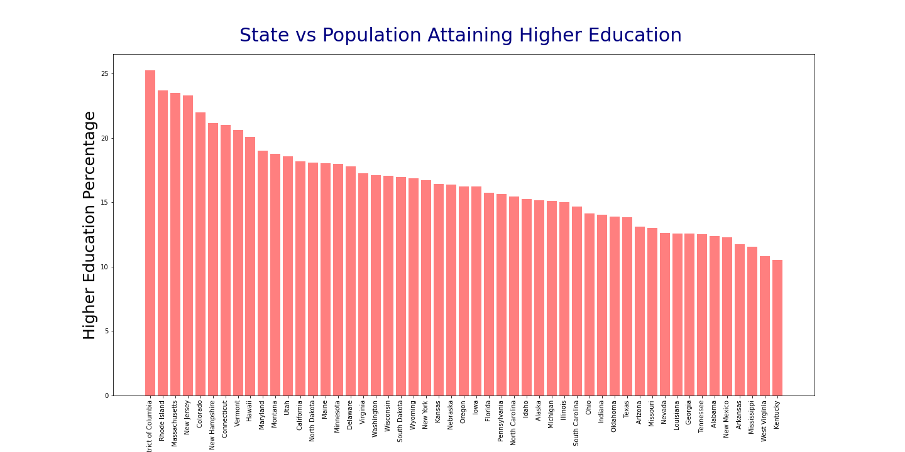
View of the data
State
Notes:
Maxbooz

Slide 7
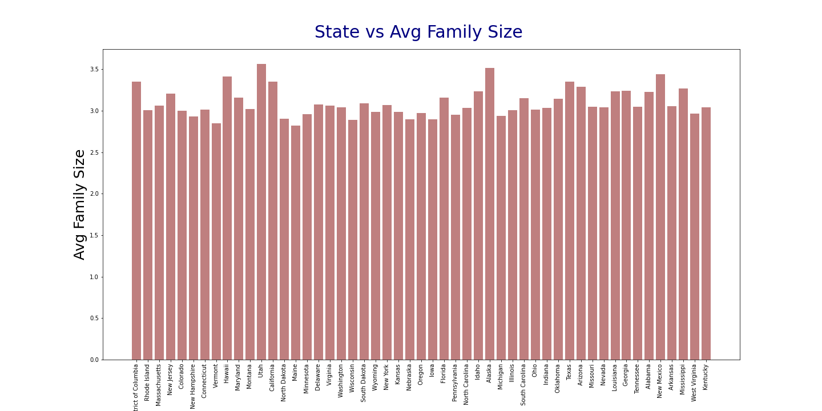
View of the data
State
Notes:
Maxbooz

Slide 8
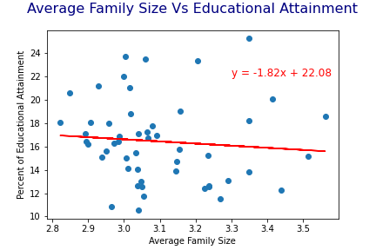
Hypothesis Analysis
Notes:
Alice
the r-value we expected for the null hypothesis (r>=0) and the alternative hypothesis(r<0)

Slide 9
Conclusion
R-value of -0.09 is too insignificant and so close to 0
We accept the null hypothesis
Notes:
Alice

Slide 10
What’s Next: How can we expand testing in the future
Include all counties
Other parameters: state median income
Geomap the data
Notes:
Jasmine
opposite of the other teams, we could expand our sample to test more or all counties.

Slide 11
Q & A
Notes:
Jasmine
Cost of higher education continues to increase
Wanted to see what some of the impacts are to being able to afford higher education
There were many different factors, but the household size was one that we had not really heard of being tested before

